Slide 1
Scientific Machine Learning for Modeling, Optimization, and Control of Dynamical Systems
Ján Drgoňa
Associate Professor Civil and Systems Engineering Department The Ralph O'Connor Sustainable Energy Institute (ROSEI)
Data Science and AI Institute (DSAI)

Slide 2
Course Syllabus
Week 1: Introduction to Scientific Machine Learning (SciML)
Week 2: Preliminaries Refresher
Week 3: Introduction to differentiable programming
Week 4: Physics-informed neural networks (PINNs)
Week 5: Neural ordinary differential equations (NODEs)
Week 6: Neural differential equations with constraints
Week 7: Learning to optimize (L2O)
Week 8: Feasibility restoration methods in L2O
Week 9: Differentiable control
Week 10: SciML applications
Week 11: Project evaluation with presentations

Slide 3
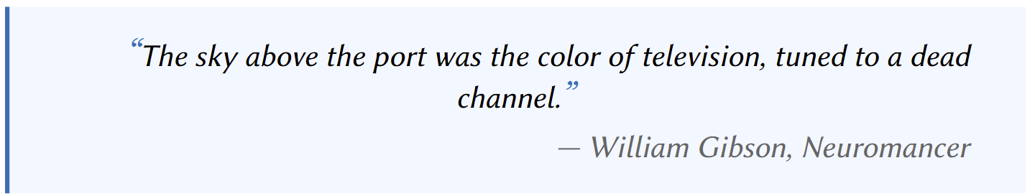
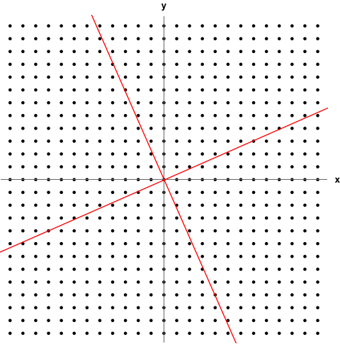

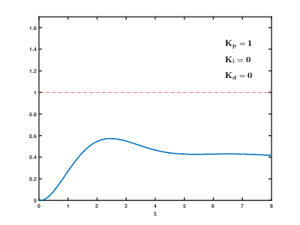
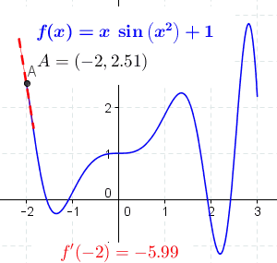
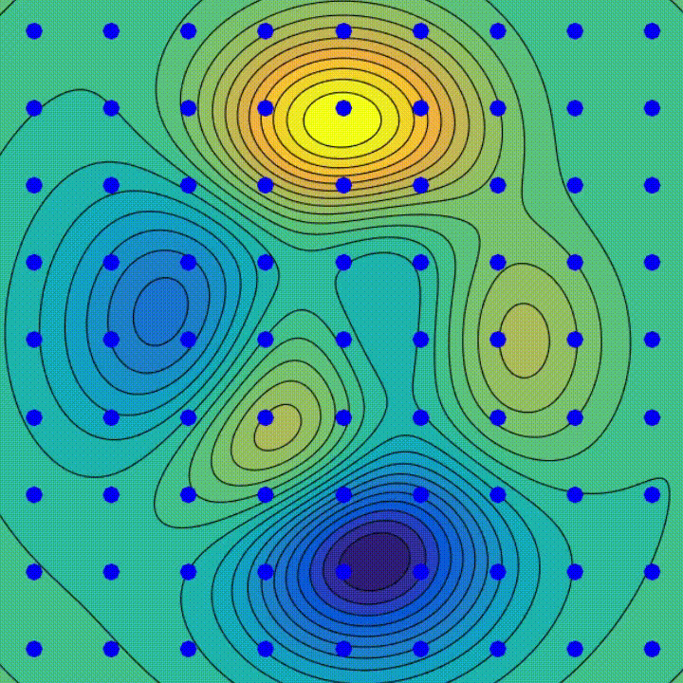
Mathematical and Algorithmic Foundations
Linear Algebra
Calculus
Optimization
Deep learning
Dynamics and Control

Slide 4
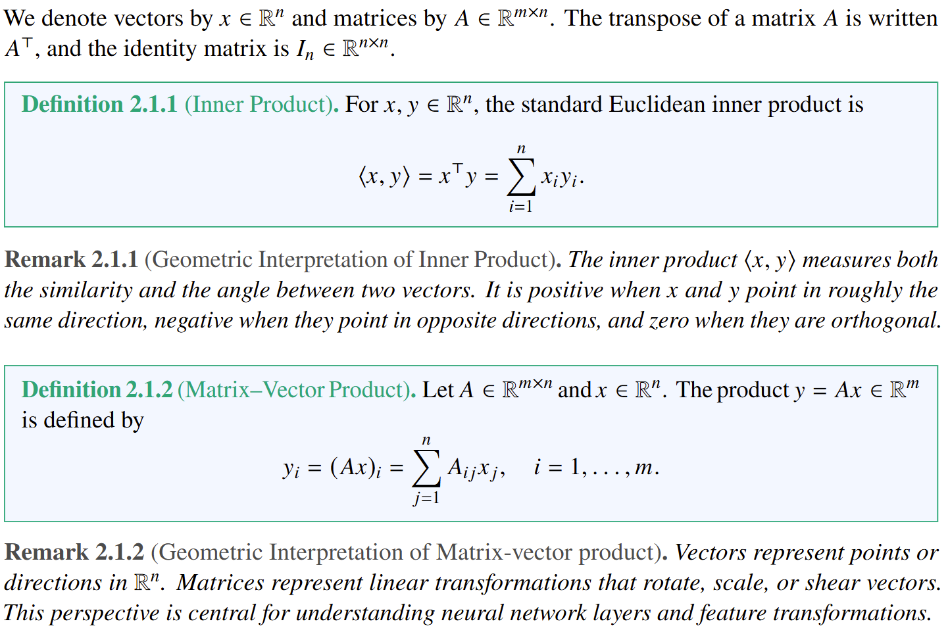
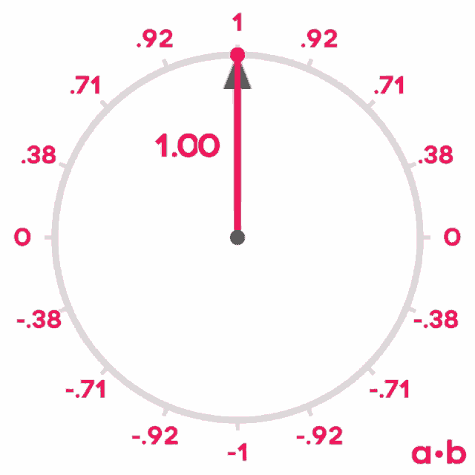
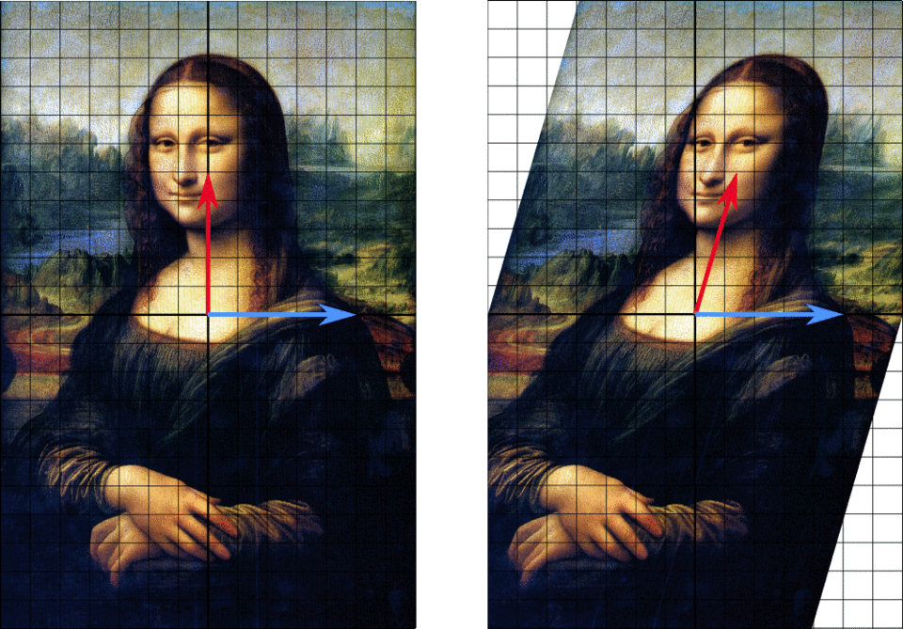
Linear Algebra
Linear algebra provides the foundation for numerical methods, optimization, and neural networks.
Inner product measures both the similarity and the angle between two vectors.
Matrices represent linear transformations that rotate, scale, or shear vectors.

Slide 5
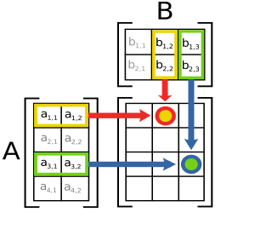
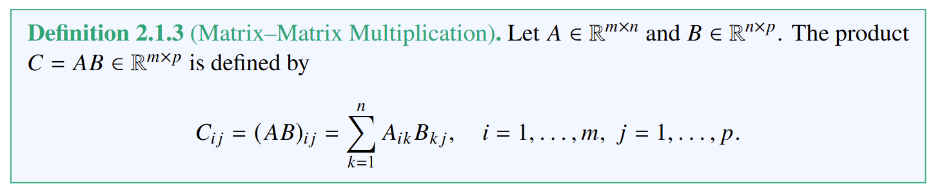
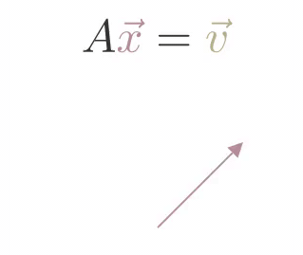
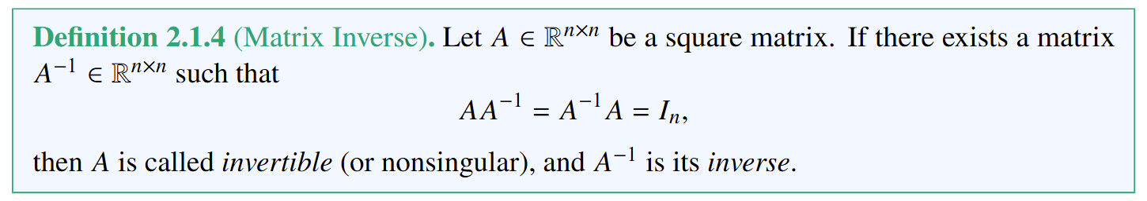
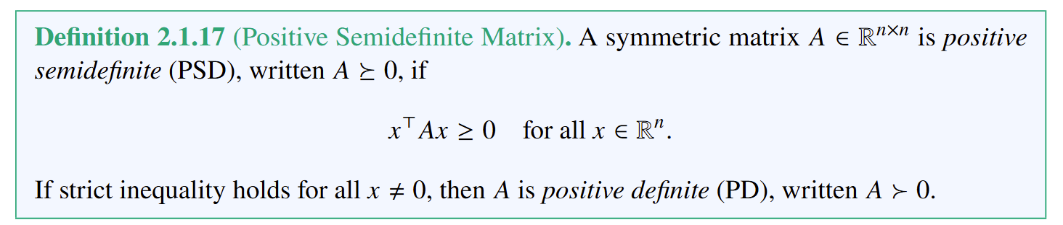
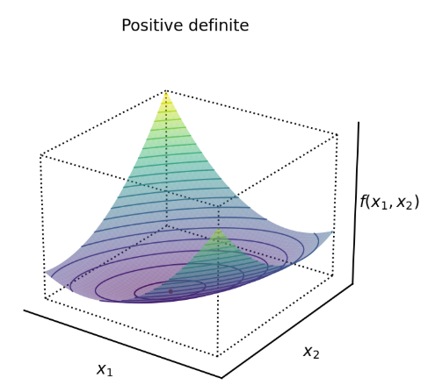
Linear Algebra
Matrix multiplication encodes composition of linear transformations.
The inverse of A represents the linear transformation that reverses the effect of A.

Slide 6
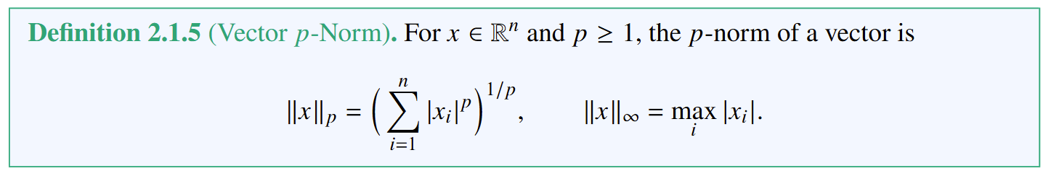
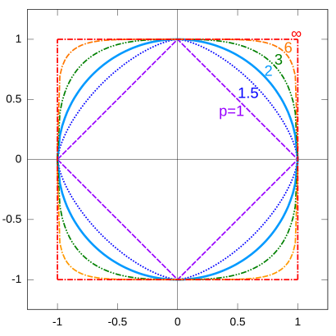
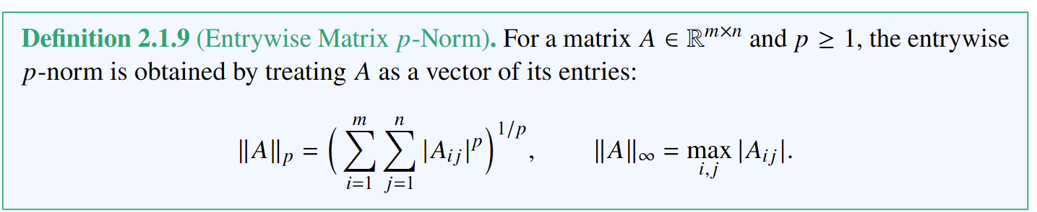
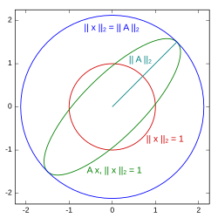
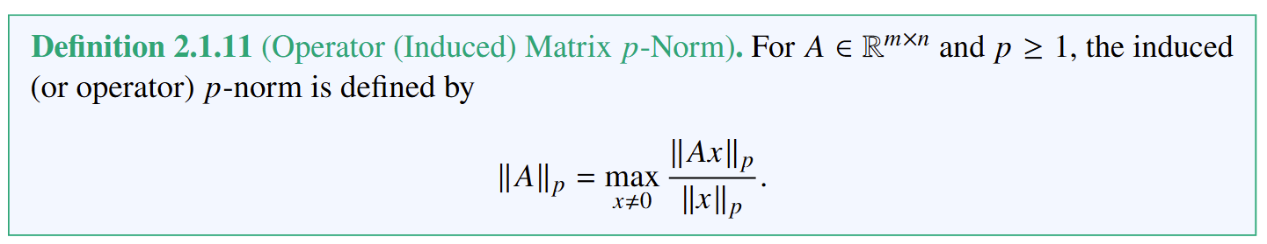
Norms
Norms quantify size, length, or energy of a vector or a matrix. They are used to measure approximation quality, impose regularization, and assess stability.
Measures the length of a matrix by flattening it into a vector.
Measures maximum factor by which 𝐴 can stretch a vector.

Slide 7
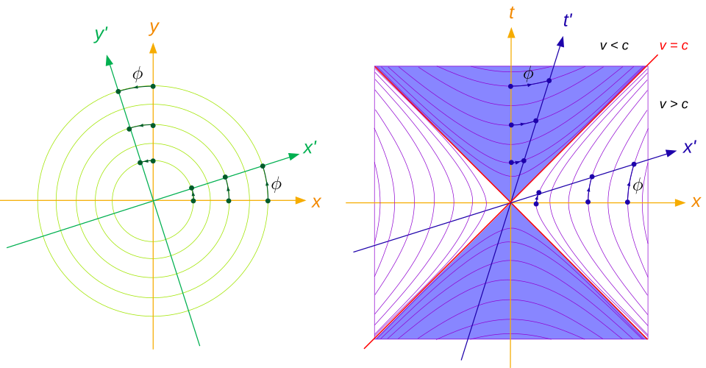
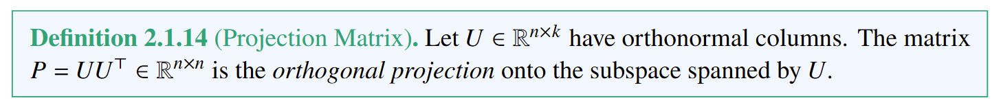
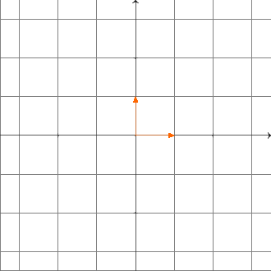
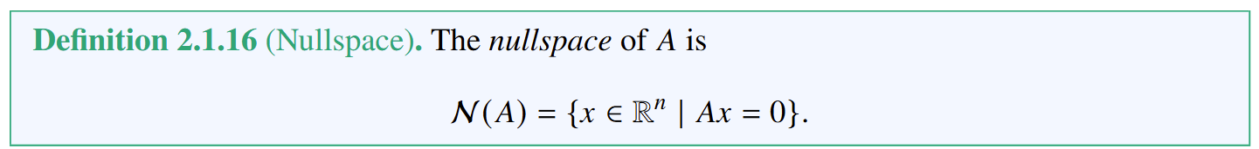
Subspaces and Orthogonality
Subspaces, orthogonality, and projections describe the geometry of linear systems.
Orthogonality generalizes the idea of vectors being perpendicular (no overlap). Orthogonal matrices preserve lengths and angles.
Projection matrices formalize the idea of dropping a vector onto a subspace.
The matrix rank measures how many independent directions its column spans, tells us the dimension of the space the matrix maps onto.
span.
The nullspace consists of all input directions that a matrix collapses to zero. It reveals hidden redundancies in a system and is key in identifiability analysis and model reduction.

Slide 8
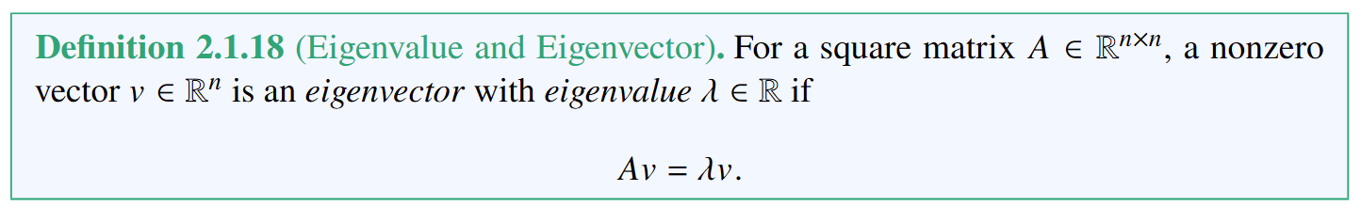
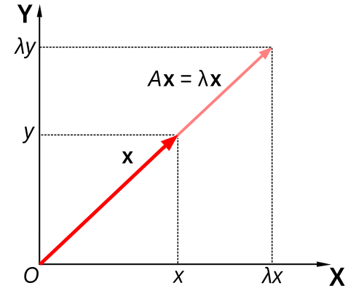
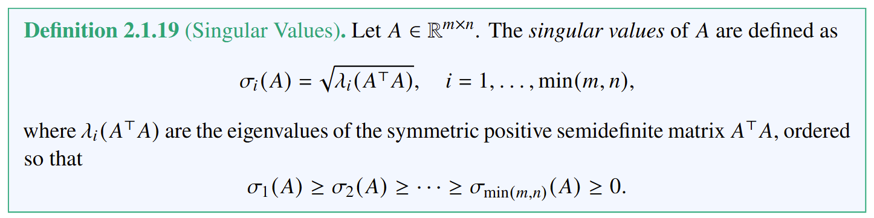

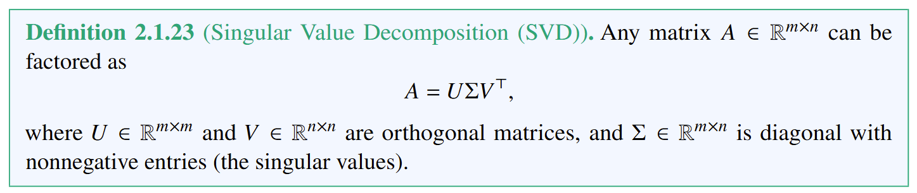
Spectral Theory
Spectral properties describe how linear transformations act along invariant (not changing) directions.
Eigenvalues capture invariant scaling directions of a linear transformation.
Singular values measure how much a matrix stretches vectors along different directions.

Slide 9
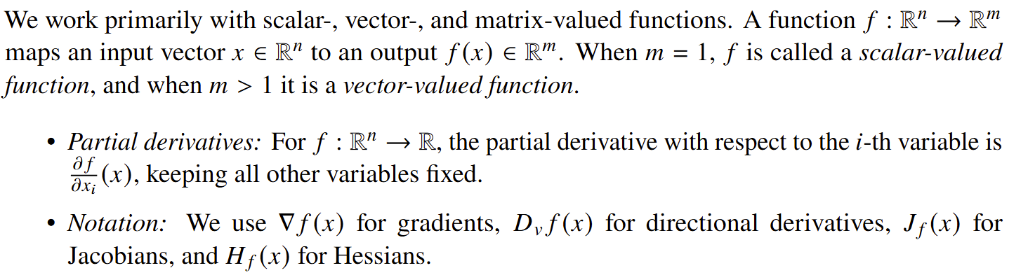
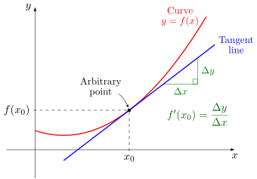
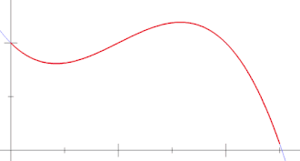
Calculus
Calculus provides the fundamental tools to understand and quantify change and accumulation.
Differential calculus
Integral calculus

Slide 10
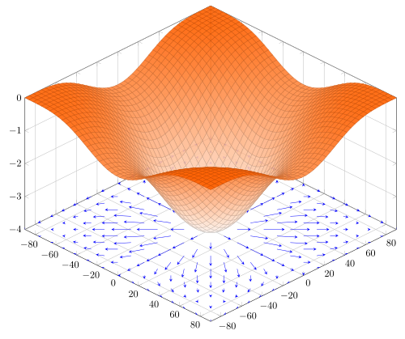
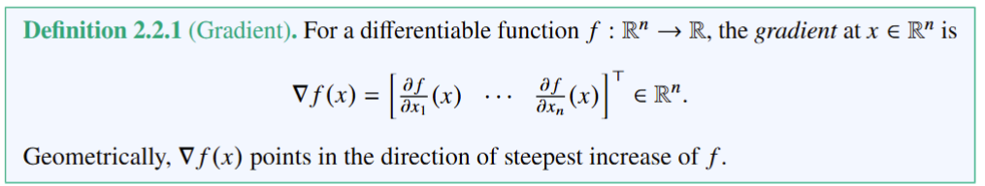
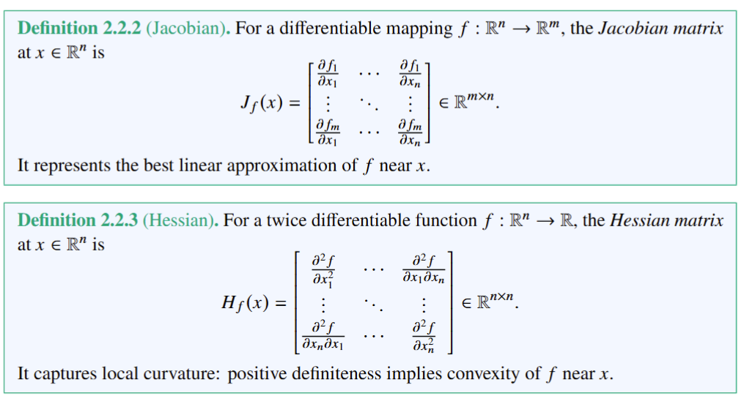
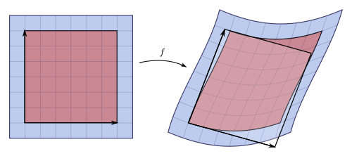
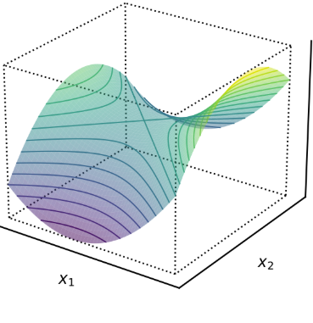
Gradients, Jacobians, and Hessians

Slide 11
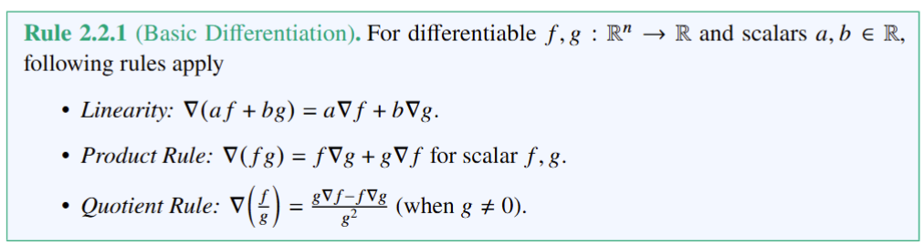
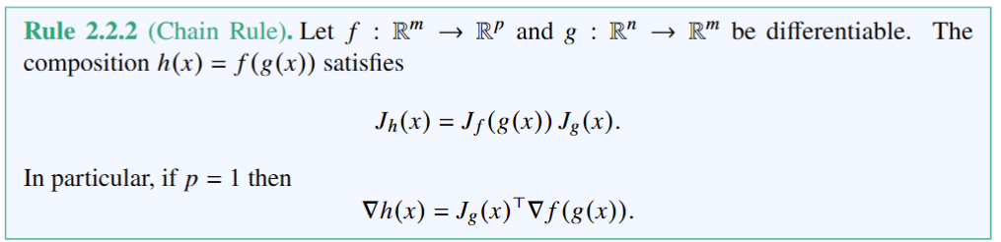
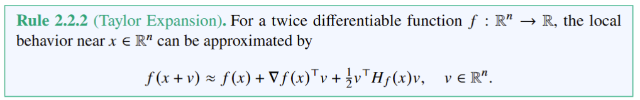
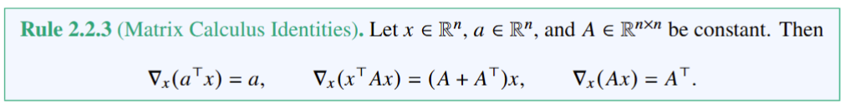
Differentiation Rules
Linearity ensures gradient operators work with sums. The product rule is essential for physics models. The quotient rule appears in normalization.
Foundation of automatic differentiation in scientific computing and backpropagation in machine learning.
Foundation of Newton’s method. Connects the gradient to the linear term (slope) and the Hessian to the quadratic term (curvature)
Used in optimization, control, and variational methods.

Slide 12
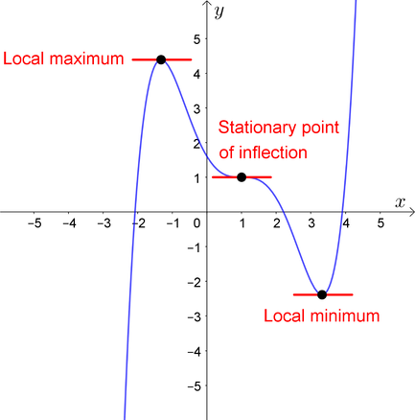
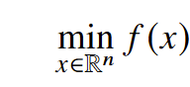
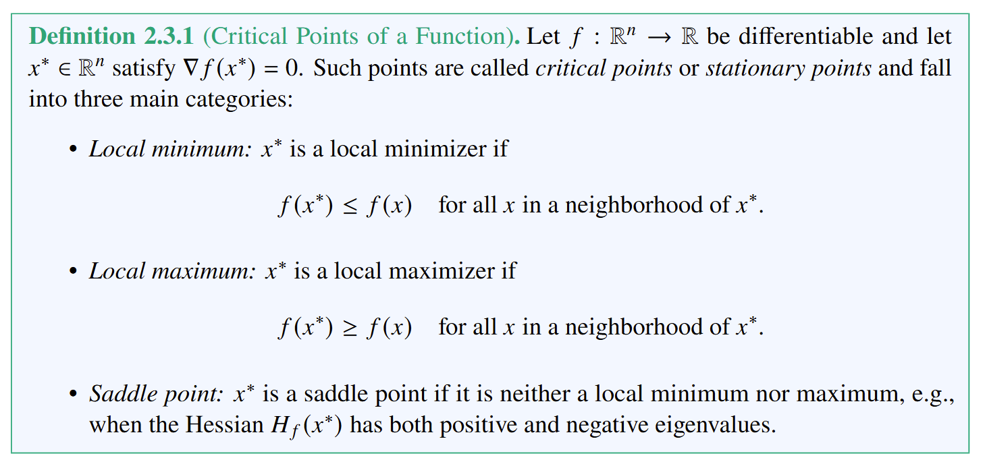
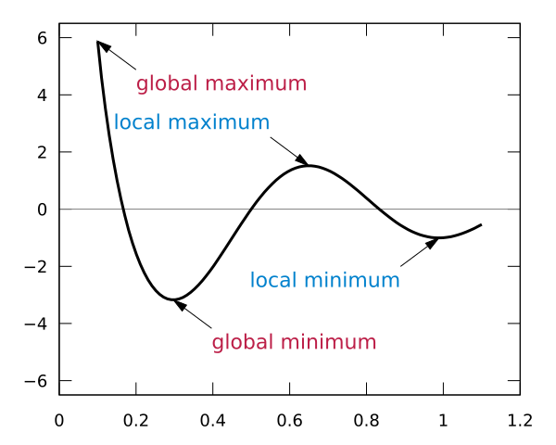
Optimization
Optimization provides the mathematical framework for finding the best decision under given criteria.
Unconstrained optimization problem:
Critical points mark the candidates for optima in optimization problems.

Slide 13
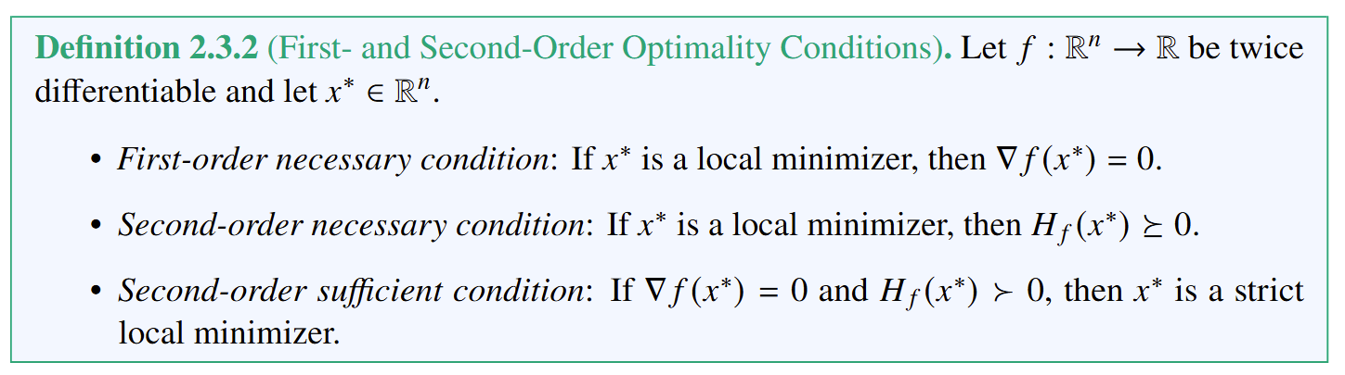
Optimization
Optimization provides the mathematical framework for finding the best decision under given criteria.
Unconstrained optimization problem:
Optimality conditions are used in optimization algorithms to find optimal solutions (extrema of a function).

Slide 14
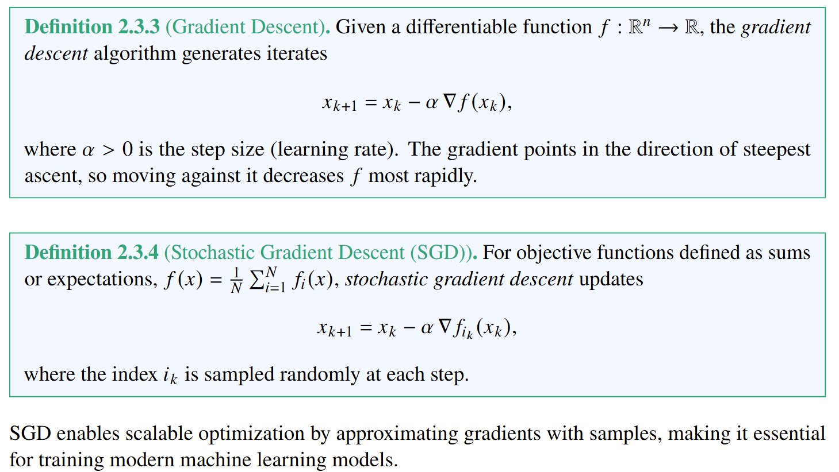
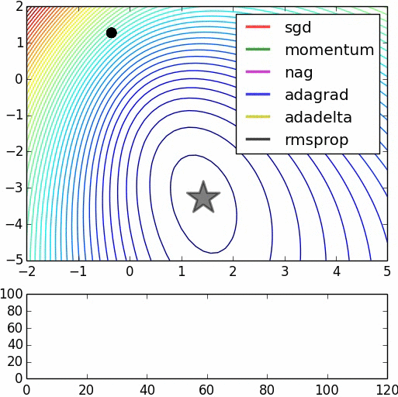
Gradient-Based Methods
Gradient descent is the fundamental iterative scheme for minimizing functions, forming the basis for most large-scale optimization and machine learning algorithms.
illustrations by Alec Radford

Slide 15

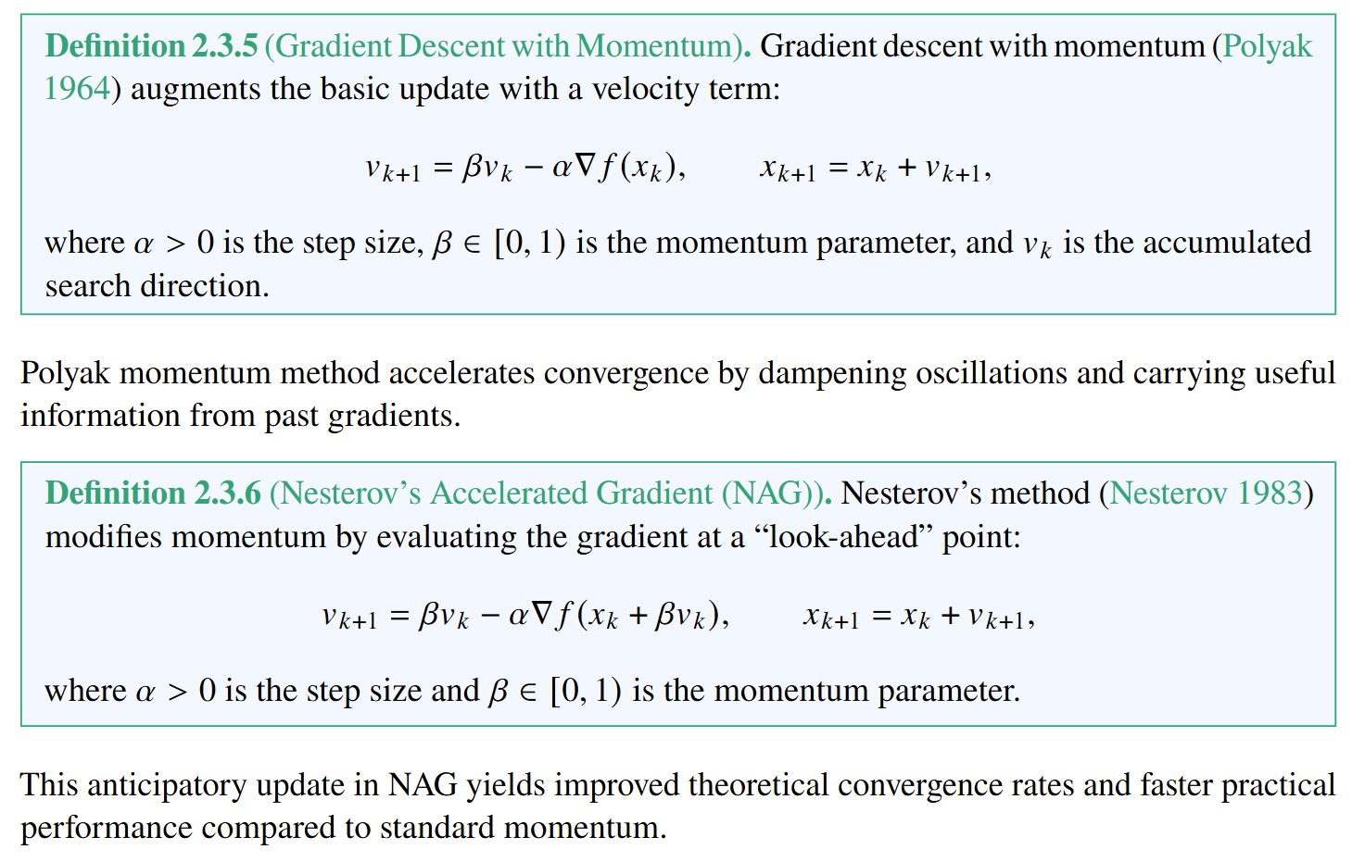

More Gradient-Based Methods
illustrations by Alec Radford

Slide 16
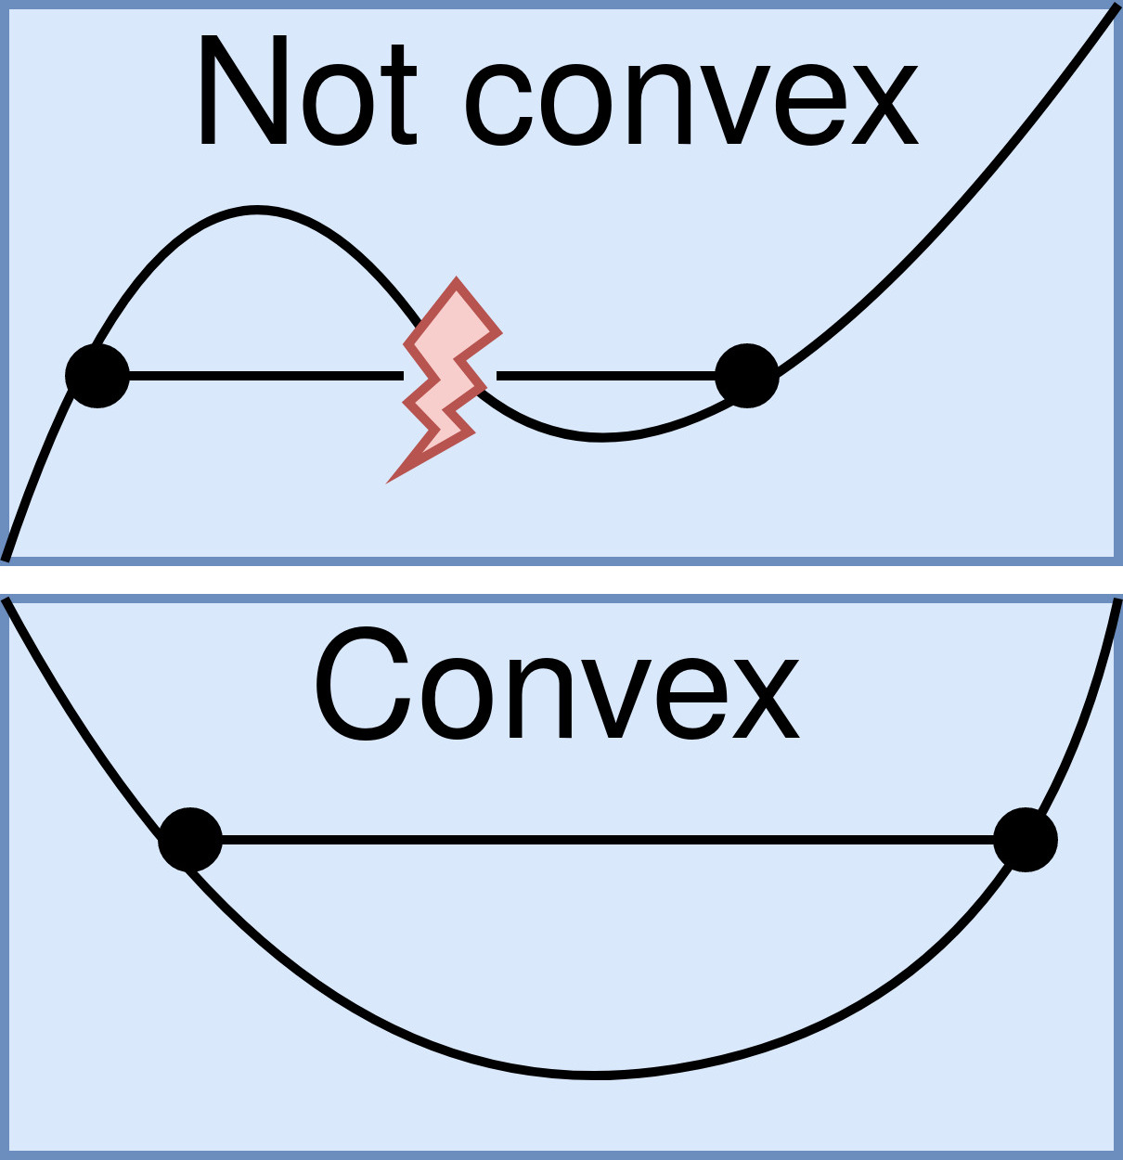
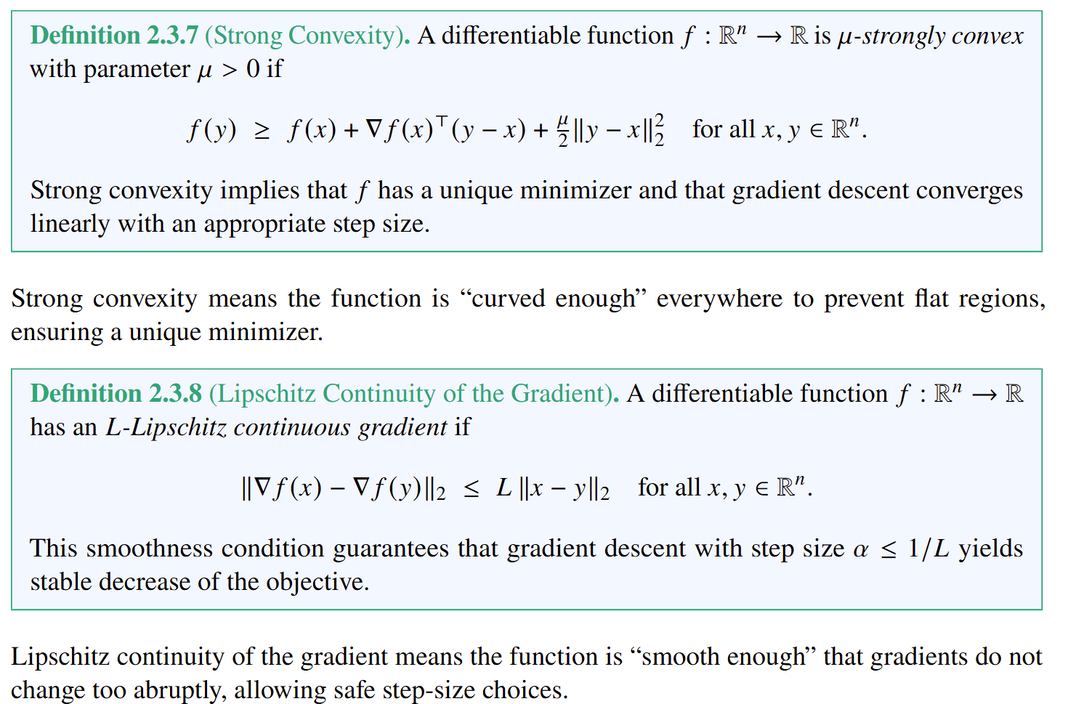
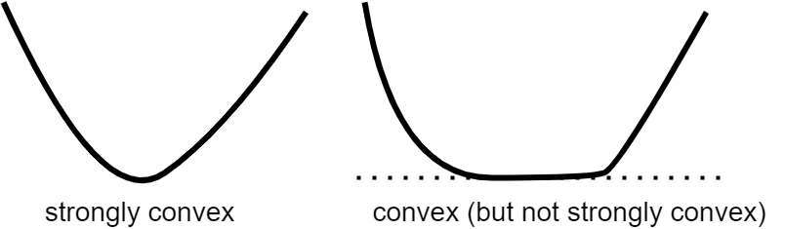

Important Properties for Gradient-Based Methods

Slide 17


Convergence of Gradient-Based Methods
The Descent Lemma formalizes the idea that smooth functions behave locally like quadratic upper bounds. This provides the key inequality used to analyze gradient descent.

Slide 18


Convergence of Gradient-Based Methods
Corollary 2.3.2 guarantees that a properly scaled gradient step always reduces the objective of a smooth function.
Theorem 2.3.3 for strongly convex and smooth functions shows that gradient descent not only decreases the objective monotonically but does so at a geometric rate, with the error shrinking by a fixed factor at each iteration.

Slide 19






Deep Neural Networks

Slide 20
Deep Neural Networks

Slide 21
Deep Neural Networks

Slide 22

Neural Networks as Universal Approximators
The Theorem 2.4.1 establishes that even shallow neural networks can approximate any continuous function on a compact domain arbitrarily well, highlighting the expressive power of neural architectures. Depth and modern activation functions improve efficiency, but the universality property already holds for single-layer networks.
Hornik, K., M. Stinchcombe, and H. White (1989). “Multilayer feedforward networks are universal approximators”. In: Neural Networks 2.5, pp. 359–366
Cybenko, G. (1989). “Approximation by superpositions of a sigmoidal function”. In: Mathematics of Control, Signals and Systems 2.4, pp. 303–314.

Slide 23





Deep Neural Network Loss Functions
Training a neural network is framed as minimizing an empirical risk defined over a dataset.

Slide 24

Training Deep Neural Network
Mini-batches allow training to scale to large datasets: instead of computing the full gradient over𝑁 samples, updates are made from small, random subsets, utilizing stochastic gradient descent (SGD).
Deep learning commonly employs adaptive optimizers such as Adagrad, and Adam which adjust step sizes per parameter and handle noisy gradients effectively, improving training robustness on large-scale datasets.
Duchi, J., E. Hazan, and Y. Singer (2011). “Adaptive subgradient methods for online learning and stochastic optimization”. In: Journal of Machine Learning Research 12.61, pp. 2121–2159
Kingma, D. P. and J. Ba (2015). “Adam: A method for stochastic optimization”. In: International Conference on Learning Representations (ICLR). arXiv:1412.6980.

Slide 25
Homework
HW1: Algorithmically generate similar plots.
Compare different optimization algorithms and different non-convex objective functions.
Submit as single .py file that generates gif or png file.
HW2 (Optional): Derive convergence proof for gradient descent using Descent Lemma.

Slide 26
Week 11: Project Presentations and Evaluation
Projects cover 50% of the course grade!
Project progress report 10% - week 8
Project final report 20% - week 10
Project presentation 20% - week 11
Project format.
Project technical report: 4-5 page pdf document including references and figures.
Project presentation: ppt or pdf slides, 15 min time slot per student in week 11.
Admissible topics.
Application of selected SciML methods to problems inspired by real-world applications
e.g., L2O for large scale optimization of energy systems.
Development of new methods tackling some of the open challenges in SciML
e.g., novel way of utilizing PINNs in differentiable control for PDEs.
New theory supporting selected SciML methodology
e.g., convergence analysis of feasibility restoration layers in L2O.

